Slide 1
Data Analysis on IPL Bowling Economy Analysis
Source:https://drive.google.com/file/d/17wcHW9J0FWR5P09XYeqTE4qcl_b6CjL9/view?usp=sharing
Dataset: Best Bowling Economy Per Innings All Seasons.csv
📩 Email: sagararavind87@gmail.com
📞 Phone: 8519881965
LinkedIn:https: //www.linkedin.com/in/aravind-pedhabudhi/

Slide 2
INITIAL ANALYSIS OF THE DATASET
The dataset contains a total of 2100 entries.
It highlights the most economical bowling performances, sorted by the bowler's economy rate.
The best performance listed belongs to Mohammad Hafeez, who had an economy rate of 2.0 after giving away only 8 runs in 4 overs.
The second-best economy rate of 2.25 is shared by three players: Ishant Sharma, Brett Lee, and Shaun Pollock.
Other notable performances in the top ten include spells from Dominic Thornely, Sourav Ganguly, Sohail Tanvir, and Irfan Pathan.

Slide 3
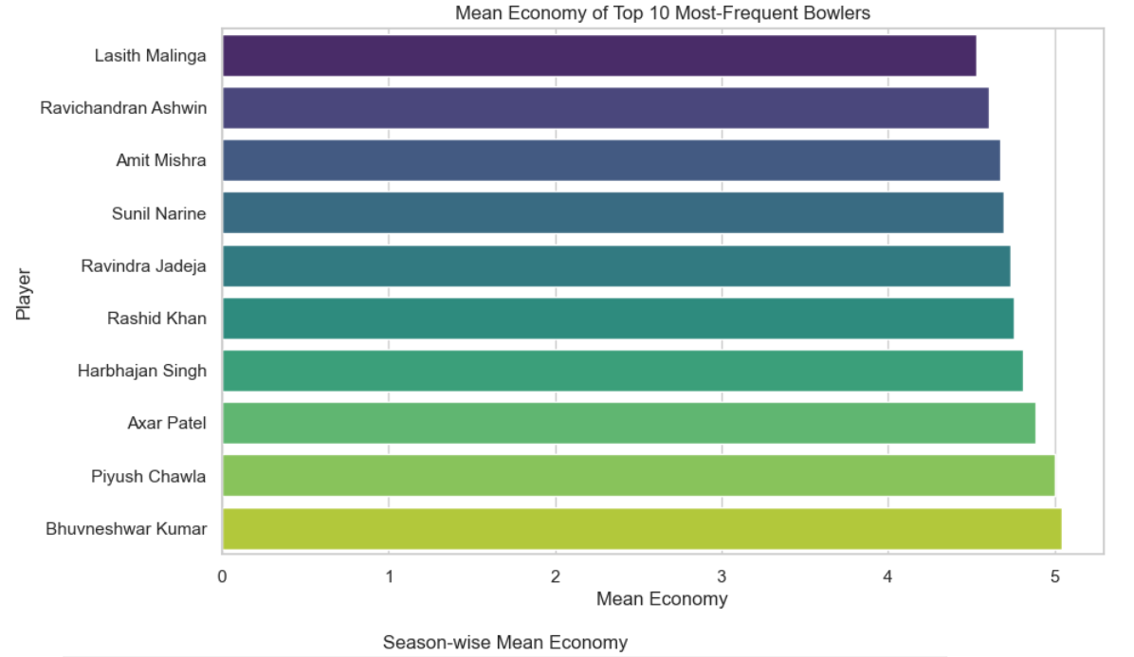
Distribution of Player and Season-wise Mean Economy
Therefore, while Hafeez has the best individual record, Khan is the most consistently economical bowler in the dataset .
For consistency, Rashid Khan is the most notable player, as he appears more frequently than any other bowler in the list of top performances .

Slide 4
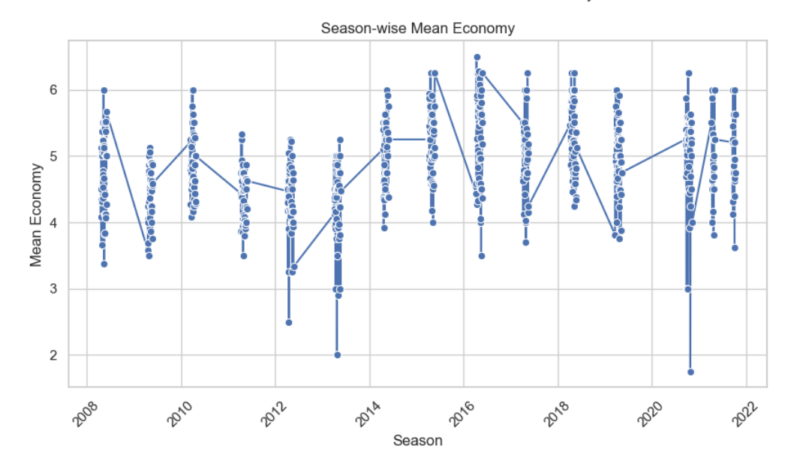
Distribution of Mean Economy and Season
Therefore, while Hafeez has the best individual record, Khan is the most consistently economical bowler in the dataset .
For consistency, Rashid Khan is the most notable player, as he appears more frequently than any other bowler in the list of top performances .

Slide 5
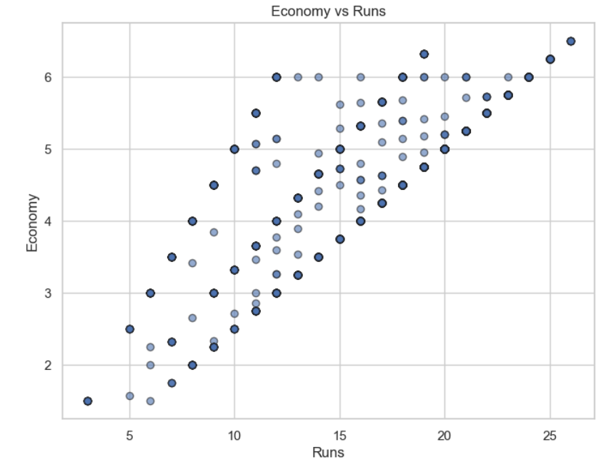
Distribution of Economy and Runs
Therefore, while Hafeez has the best individual record, Khan is the most consistently economical bowler in the dataset .
For the most consistent performance: While Hafeez has the best single entry, Rashid Khan is the bowler who appears most frequently throughout the entire dataset of 2100 top performances. His repeated presence on a list of the most economical spells highlights his consistent ability to restrict runs at an elite level across multiple seasons.

Slide 6
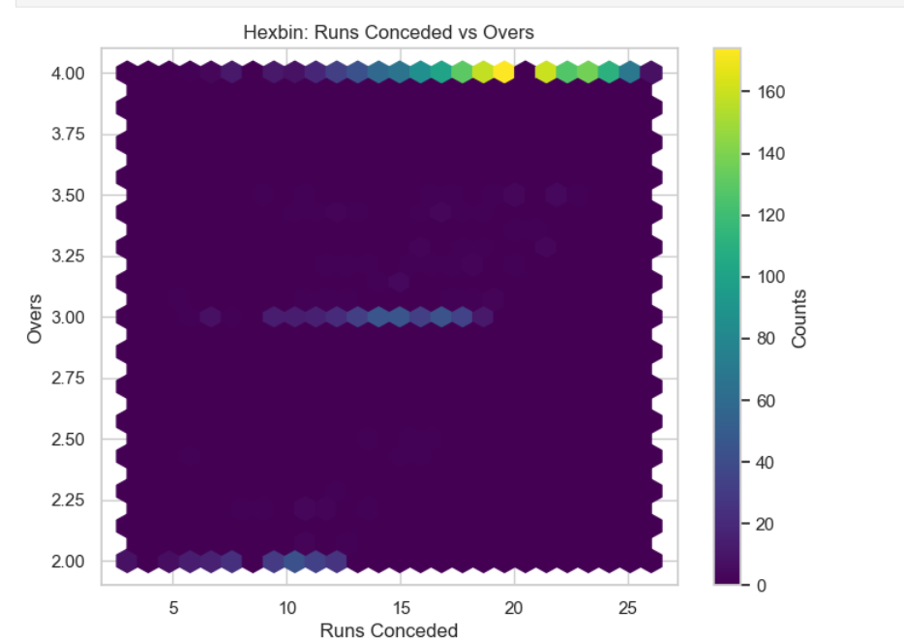
Hexbin for Runs vs Overs
Explaination:This hexbin plot visualizes the density of bowling performances, showing the most frequent combinations of overs bowled and runs conceded from the dataset.
The most common elite bowling performance is a full 4-over spell that concedes 20-25 runs

Slide 7
Conclusion
This project successfully analyzed IPL bowler performance using economy rate as the key metric, leveraging Big Data Analytics techniques with tools like Python and PySpark.
The analysis identified top individual performances, consistently economical bowlers, and variations in economy rates across different seasons and against various opponents.
Key findings show that some bowlers maintain exceptional consistency, average economy rates fluctuate seasonally, and teams vary in their vulnerability to restrictive bowling.
The project demonstrates the power of Big Data Analytics in sports, offering deep insights that are valuable for coaches, analysts, and fans alike.

